Slide 1
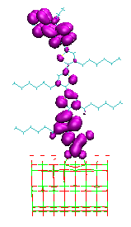
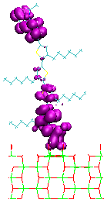
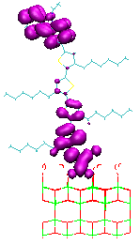
A
B
C
Electron density calculated at different time period for the (A): {101}-TiO_{2,} (B): {010}-TiO₂ (C): {001}-TiO₂

